Slide 1
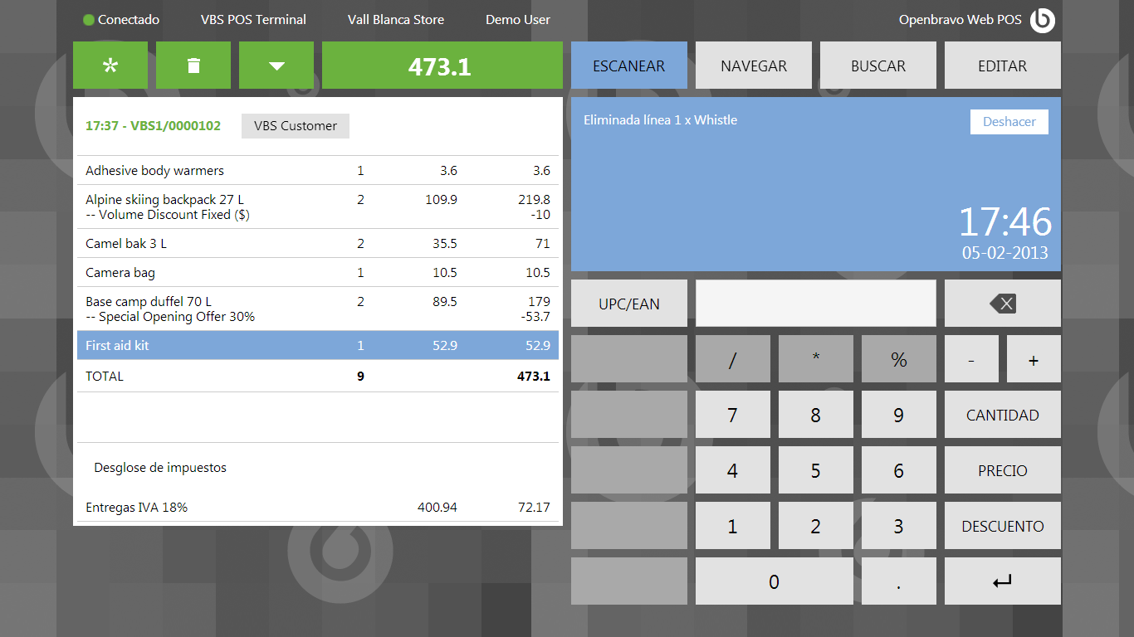
We should show here always 2 decimals
This adds up 473.11

Slide 2
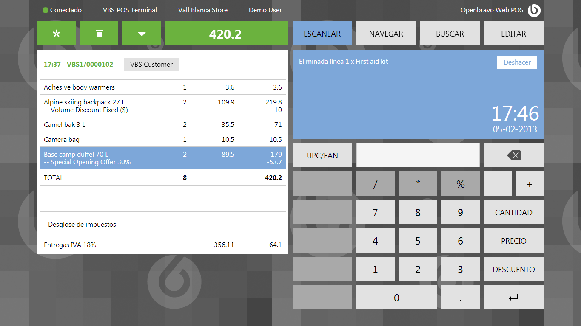
This adds up 420.21

Slide 3
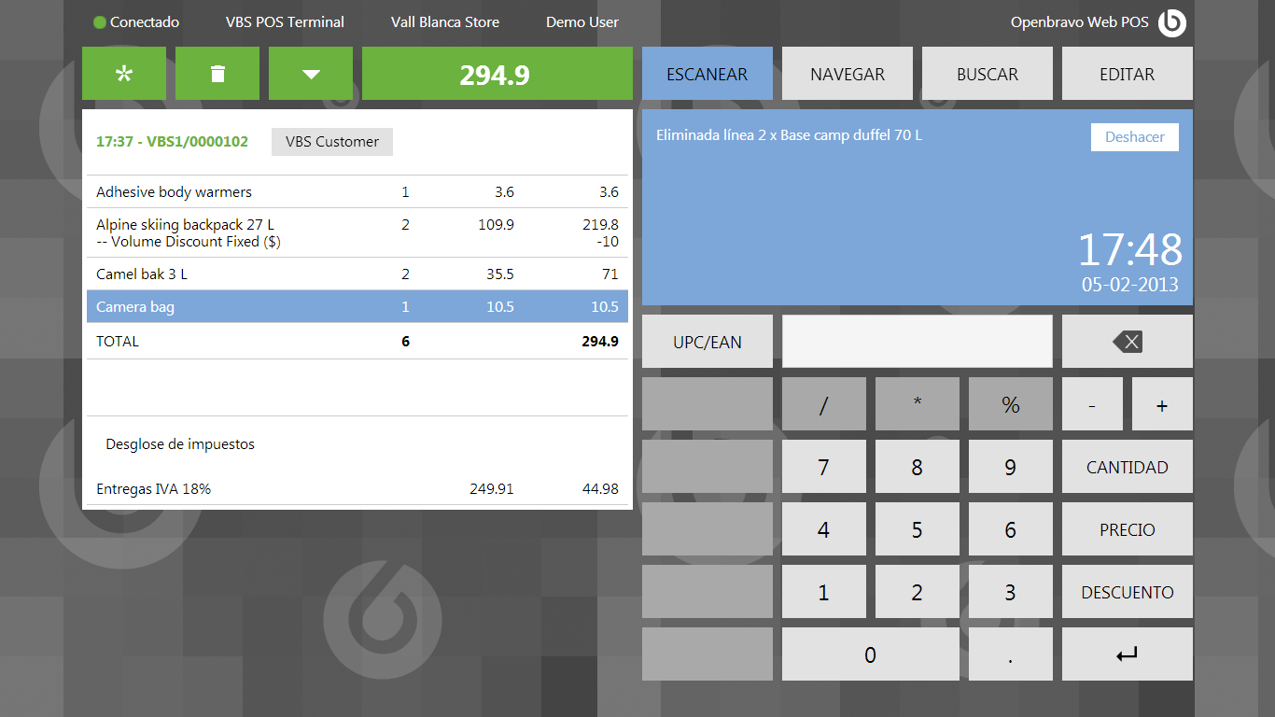
This adds up 294.89

Slide 4
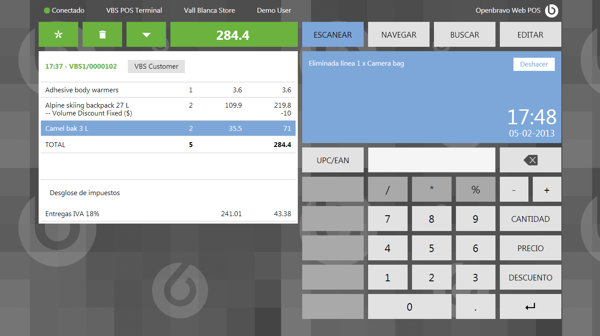
This adds up 284.39

Slide 5
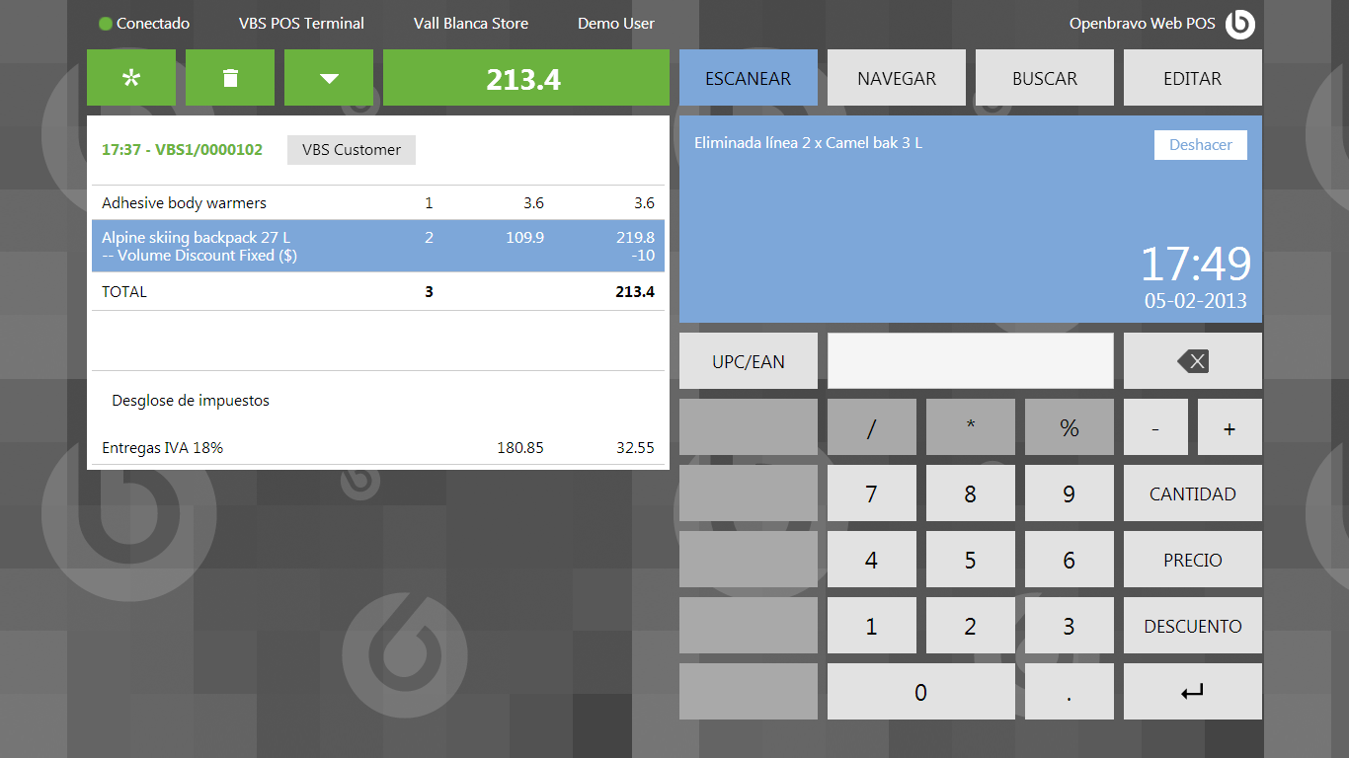
This adds up 213.40

