Slide 1
Approval asked too many times
In WebPOS REACT :
When adding amanual discount for several products :
When a pline is added : the approval window is displayed as many times as there are product lines requiring approval

Slide 2
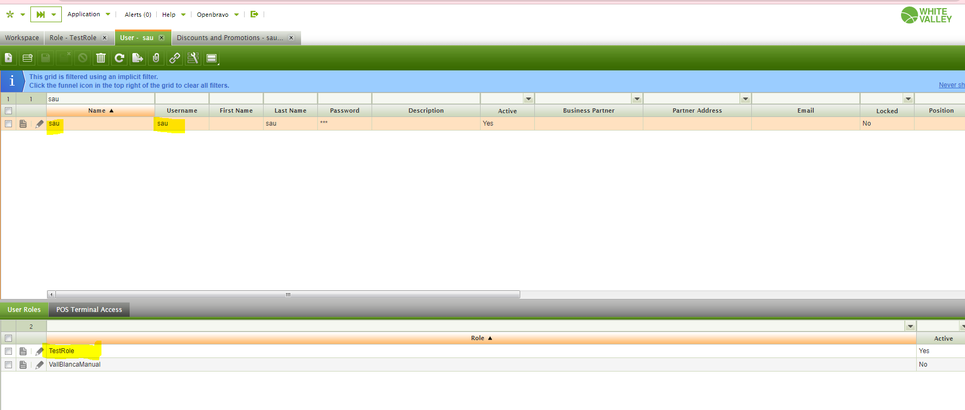
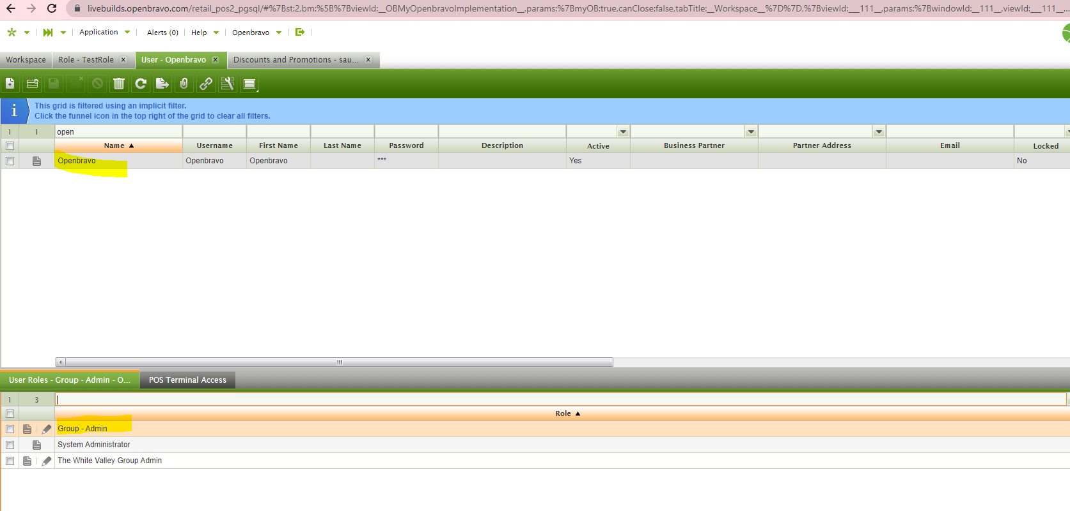
Rôle / user

Slide 3
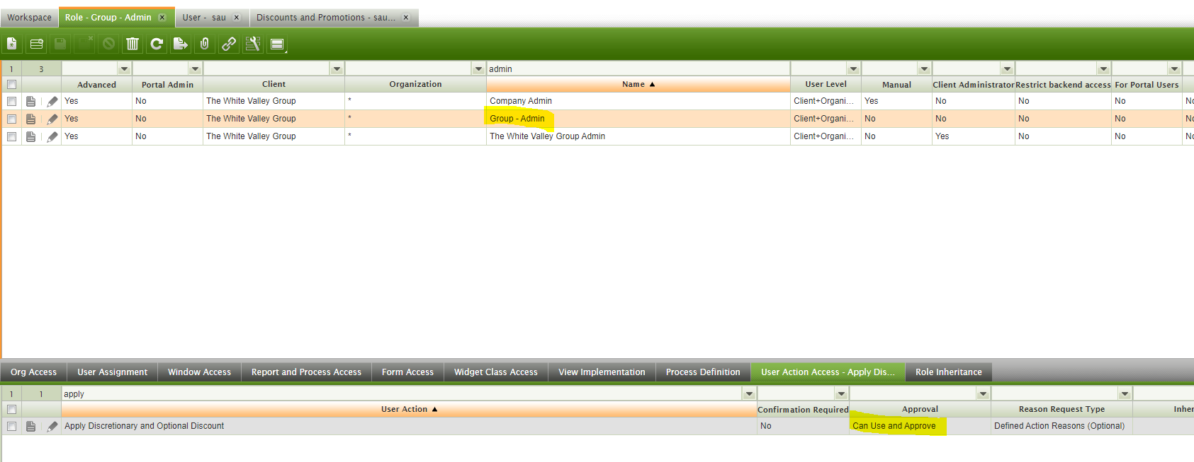
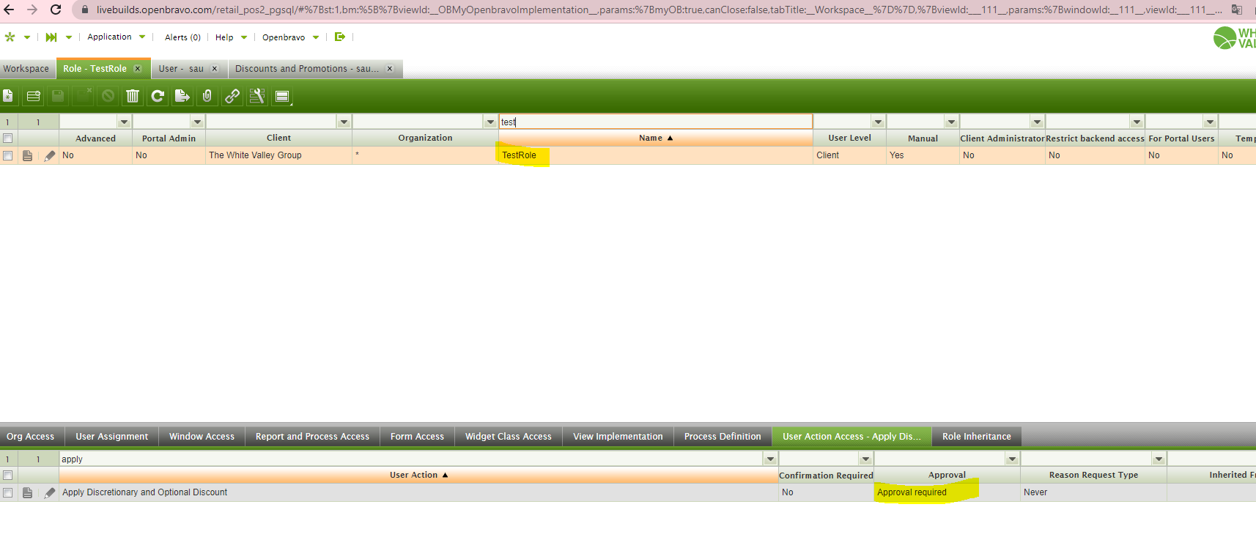
UserAction / role

Slide 4
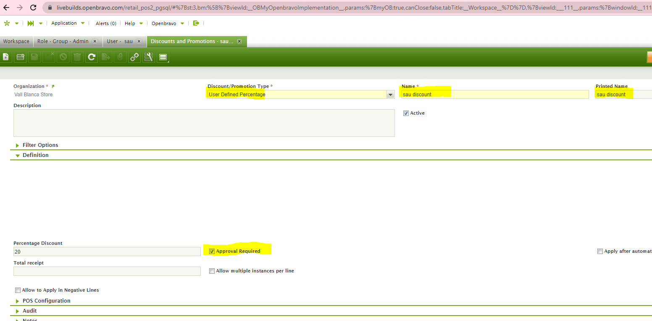
Discount

Slide 5
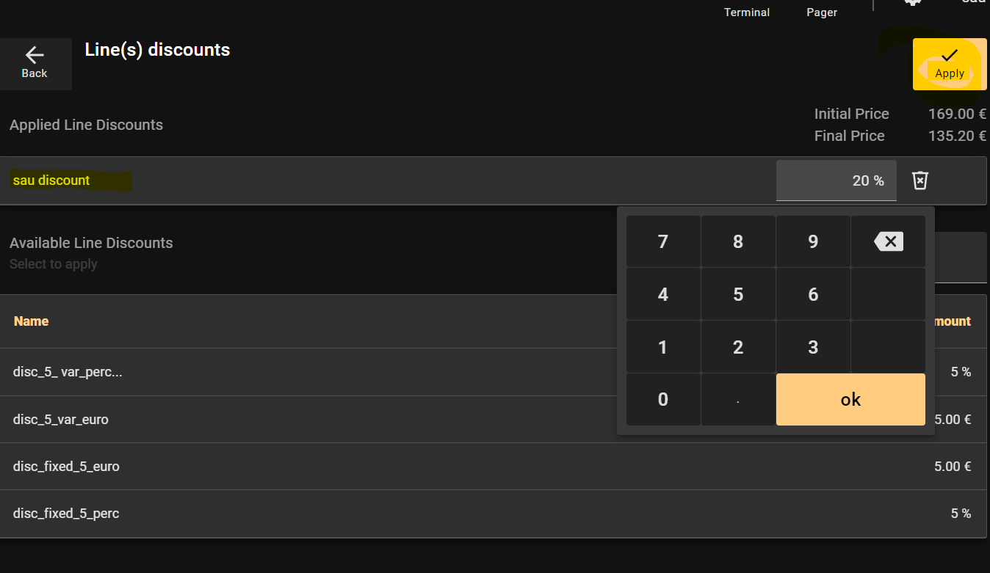

Slide 6
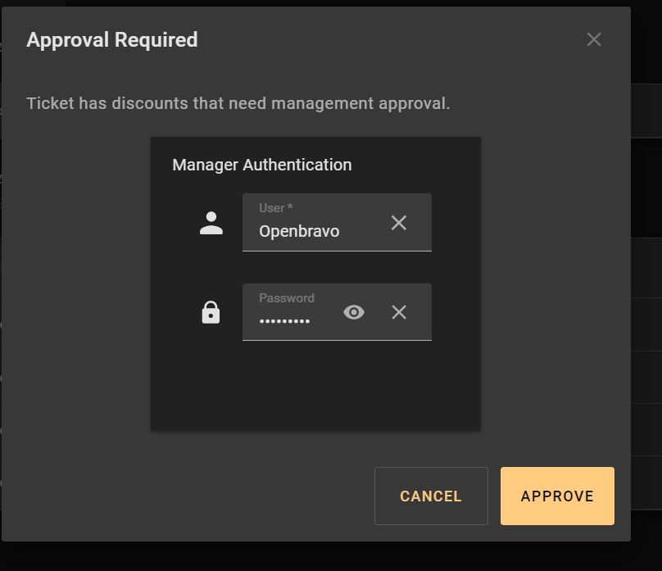
Test case :
Add 1st product with this discount
🡺 Approval is asked : OK
Add 2nd product with this discount :
Approval is asked twice (because 2 lines need approval 🡺 KO : only one is expected
Add 3rd product with this discount :
Approval is asked 3 times (because 3 lines need approval 🡺 KO : only one is expected

Slide 7
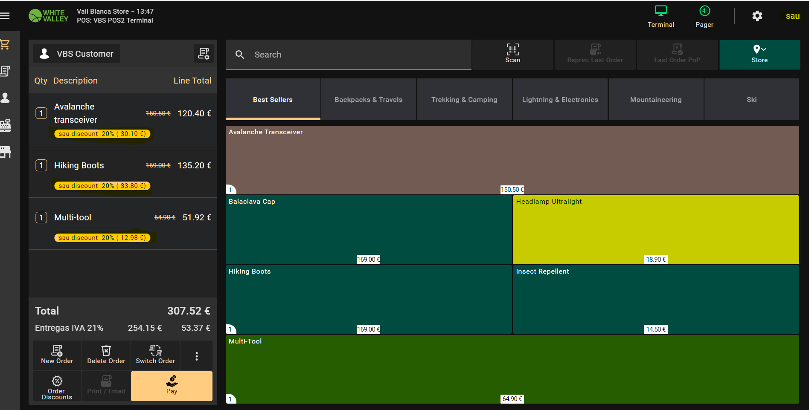
Discount correctly applied

